Slide 1
ATAG Beginner's Guide to Sustainable Aviation Fuel
UNESCO CHAIR OF UPB

Slide 2
Introduction
Today, we will explore the importance of sustainable aviation fuel (SAF) and its role in achieving a more environmentally responsible aviation industry.

Slide 3
Why Sustainable Aviation Fuel (SAF)?
Climate change and the aviation industry: The aviation industry acknowledges its contribution to global carbon emissions and is committed to reducing its environmental impact.
SAF as a solution: Sustainable aviation fuel provides an effective means to reduce aviation's carbon footprint and combat climate change.

Slide 4
What is Sustainable Aviation Fuel (SAF)?
Definition of SAF: Sustainable aviation fuel, also known as biojet fuel or renewable jet fuel, is a drop-in fuel made from sustainable feedstocks such as waste oils, agricultural residues, or non-food crops.
Similarities to conventional jet fuel: SAF can be used in existing aircraft and infrastructure without requiring significant modifications.

Slide 5
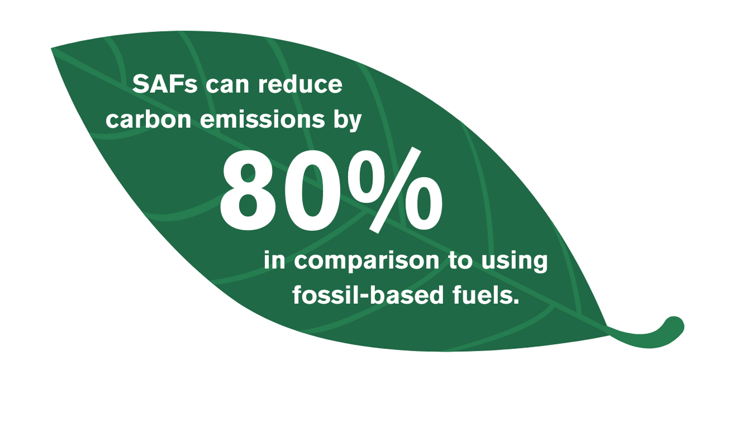
Benefits of Sustainable Aviation Fuel (SAF)
Reduction of carbon emissions: SAF significantly reduces lifecycle greenhouse gas emissions compared to conventional jet fuel, leading to a lower carbon footprint for the aviation industry.
Improved air quality: SAF has the potential to reduce emissions of air pollutants, such as sulfur oxides (SOx) and nitrogen oxides (NOx), resulting in improved local air quality around airports and communities.
Renewable and sustainable feedstocks: SAF can be produced from various sustainable feedstocks, promoting resource efficiency and contributing to a circular economy.

Slide 6
Availability and Production of SAF
Current production levels: While SAF production is increasing, it represents a small percentage of total aviation fuel consumption.
Scaling up production: Efforts are underway to expand production capacity and establish sustainable supply chains to meet the growing demand for SAF.
Collaboration and policy support: Industry stakeholders, governments, and organizations like ATAG are working together to promote investments, research, and development to accelerate SAF production.

Slide 7
Future Perspectives and Challenges
Technological advancements: Continued research and development are essential to enhance the production processes and reduce the cost of sustainable aviation fuel.
Policy frameworks and incentives: Governments and international organizations play a vital role in creating supportive policies and offering financial incentives to facilitate the adoption of SAF.
Public awareness and collaboration: Raising awareness among stakeholders, including airlines, airports, and travelers, is crucial for driving demand and collaboration in the sustainable aviation fuel sector.

Slide 8
Conclusion
Sustainable aviation fuel is a key enabler for the aviation industry's transition towards a more sustainable and environmentally responsible future.
By adopting and increasing the use of SAF, we can significantly reduce carbon emissions, improve air quality, and support the development of a circular economy.
ATAG remains committed to promoting the adoption of sustainable aviation fuel and collaborating with stakeholders to create a greener and more sustainable aviation industry.

