Slide 1
Fit for 55: Sustainable Aviation in the EU
UNESCO CHAIR of UPB

Slide 2
The Objectives of Fit for 55
The primary objective of Fit for 55 is to ensure that the European Union meets its commitment to reducing greenhouse gas emissions by 55% by 2030.
The package includes a wide range of measures across various sectors, including aviation, to support the EU's climate goals.

Slide 3
Sustainable Aviation Initiatives
Inclusion of Aviation in the ETS:
Fit for 55 proposes the extension of the EU Emissions Trading System (ETS) to cover intra-European flights.
By including aviation in the ETS, a market-based mechanism is established to incentivize airlines to reduce their carbon emissions.

Slide 4
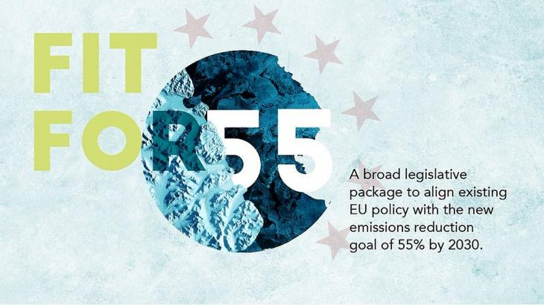
Sustainable Aviation Initiatives (continued)
Sustainable Aviation Fuels:
The package promotes the use of sustainable aviation fuels (SAFs) to reduce the carbon footprint of the aviation industry.
Incentives and requirements are introduced to increase the production and availability of SAFs, ensuring their compatibility with existing aircraft and infrastructure.

Slide 5
Sustainable Aviation Initiatives (continued)
R&D and Innovation:
Fit for 55 emphasizes the importance of research and development (R&D) and innovation in driving sustainable aviation.
Funding and support programs will be implemented to encourage the development of new technologies, such as electric and hybrid aircraft, and more efficient air traffic management systems.

Slide 6
Impacts and Challenges
Implementing the Fit for 55 package in the aviation sector will require substantial efforts and collaboration between stakeholders.
Airlines will need to invest in new technologies, infrastructure, and operational changes to meet the emission reduction targets.
The affordability and availability of sustainable aviation fuels may pose challenges that need to be addressed.

Slide 7
Conclusion
The Fit for 55 package represents a significant step towards a more sustainable aviation industry in the EU.
By integrating aviation into the ETS, promoting sustainable aviation fuels, and supporting R&D efforts, the package aims to reduce emissions and drive innovation.
It is crucial for all stakeholders, including airlines, airports, and policymakers, to collaborate and work towards a greener and more efficient aviation sector.
The creation of new learning systems for HE procedures for SAF innovation and implementation could be the expected progress.

