Slide 1
Flightpath 2050
UNESCO Chair of UPB 2023

Slide 2
Key Objectives
Flightpath 2050 Objectives:
Reducing CO2 Emissions:
Goal: Reduce CO2 emissions from aviation by 75%.
Innovative Technologies: Developing more fuel-efficient aircraft, engines, and improved aerodynamic design.
Alternative Fuels: Utilizing sustainably sourced biofuels and developing low-carbon emission fuels.
Noise Reduction:
Goal: Reducing aircraft-generated noise.
Quieter Aircraft: Utilizing advanced materials and technologies to reduce noise produced by engines and structures.
Noise Mitigation Measures: Implementing urban planning, flight management, and airport design strategies to minimize noise impact on communities.
Enhancing Air Transport Efficiency:
Improved Airport Infrastructure: Upgrading and expanding airport infrastructure to increase efficiency and capacity.
Air Traffic Management: Advanced air traffic management systems to optimize routes, avoid congestion, and reduce waiting times.
Innovation and Research: Promoting innovation, new technologies, and collaboration between industry, universities, and research institutions for efficiency improvements.

Slide 3

Reducing CO2 Emissions
Goal: Reduce CO2 emissions by 75%.
Innovative Technologies: Developing aircraft with reduced fuel consumption, more efficient engines, and improved aerodynamics.
Alternative Fuels: Utilizing biofuels from sustainable sources and developing low-carbon emission fuels.

Slide 4
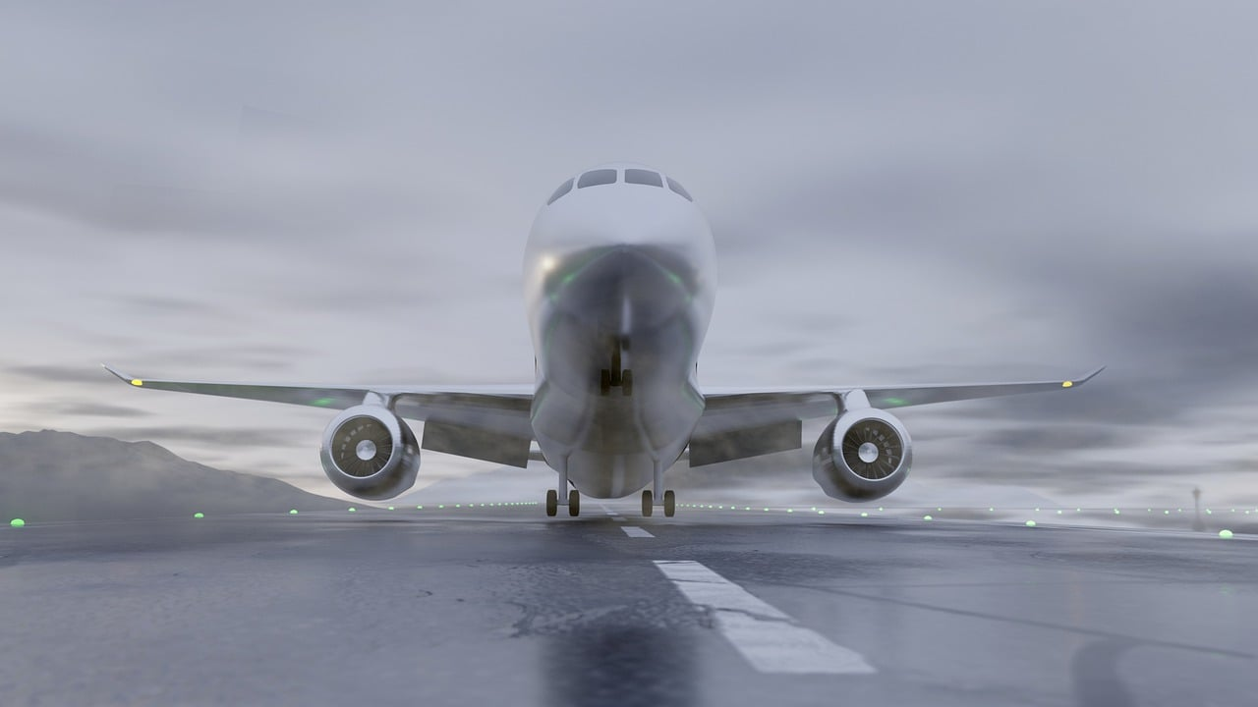
Noise Reduction
Goal: Reducing aircraft-generated noise.
Quieter Aircraft: Utilizing innovative materials and technologies to reduce engine and structural noise.
Noise Mitigation Measures: Implementing measures in urban planning, flight management, and airport design to minimize noise impact on communities.

Slide 5
Enhancing Air Transport Efficiency
Improved Airport Infrastructure: Modernizing and expanding airport infrastructure to enhance efficiency and capacity.
Air Traffic Management: Advanced systems for managing and monitoring air traffic to optimize routes, avoid congestion, and reduce delays.
Innovation and Research: Promoting innovation, new technologies, and collaboration to drive efficiency improvements in aviation.

Slide 6
Updates and Evolutions
Flightpath 2050 in the current context: In recent years, the Flightpath 2050 plan has been revised and updated to align with technological advancements and industry changes.
Potential modifications and adjustments: As technology progresses and sustainability requirements evolve, the plan may undergo modifications and adjustments to remain relevant and effective.
Sources for up-to-date information: For the latest information on Flightpath 2050, we recommend referring to the official website of the European Commission or other relevant sources.

Slide 7
Conclusion
Flightpath 2050 represents an ambitious vision for the future of European aviation, considering sustainability and efficiency.
By reducing CO2 emissions, noise, and enhancing efficiency, European aviation can play a significant role in combating climate change and improving quality of life.
Collaboration between industry, authorities, and stakeholders is essential to transform the Flightpath 2050 vision into reality.
The contribution of HE could be very useful in terms of research and teaching.
Updated study programmes lead to sustainable air transport.

